Slide 1
The population of Valley County Increased by 15.6% between the years of 2010 and 2019 (Census.gov)
Idaho Department of Lands is the second largest land holder in Valley County with just over 11% of the land in the County under their management.
Notes:
Good afternoon and thank you for the opportunity to present to the group today and also thank you to IDL for giving us all this opportunity to discuss the Payette Endowment Lands Strategy at length. Valley County has always been the “weekend getaway” for the Treasure Valley, as the Treasure Valley expands so does Valley County which adds to the number of visitors coming here to get away and the residents seeking a high quality of life close to a variety of natural amenities. The access to nature, the scenic qualities, and a diversity of opportunities for recreation are what attract new residents and visitors to Valley County alike. IDL lands represent a large portion of the county with just over 11% ownership, making them the second largest land holder behind the U.S. Forest Service. The Valley County Comprehensive Plan seeks to provide a framework for growth, development and the economic viability of the county. It outlines goals and strategies for achieving these goals while maintaining a high quality of life for its residents.

Slide 2
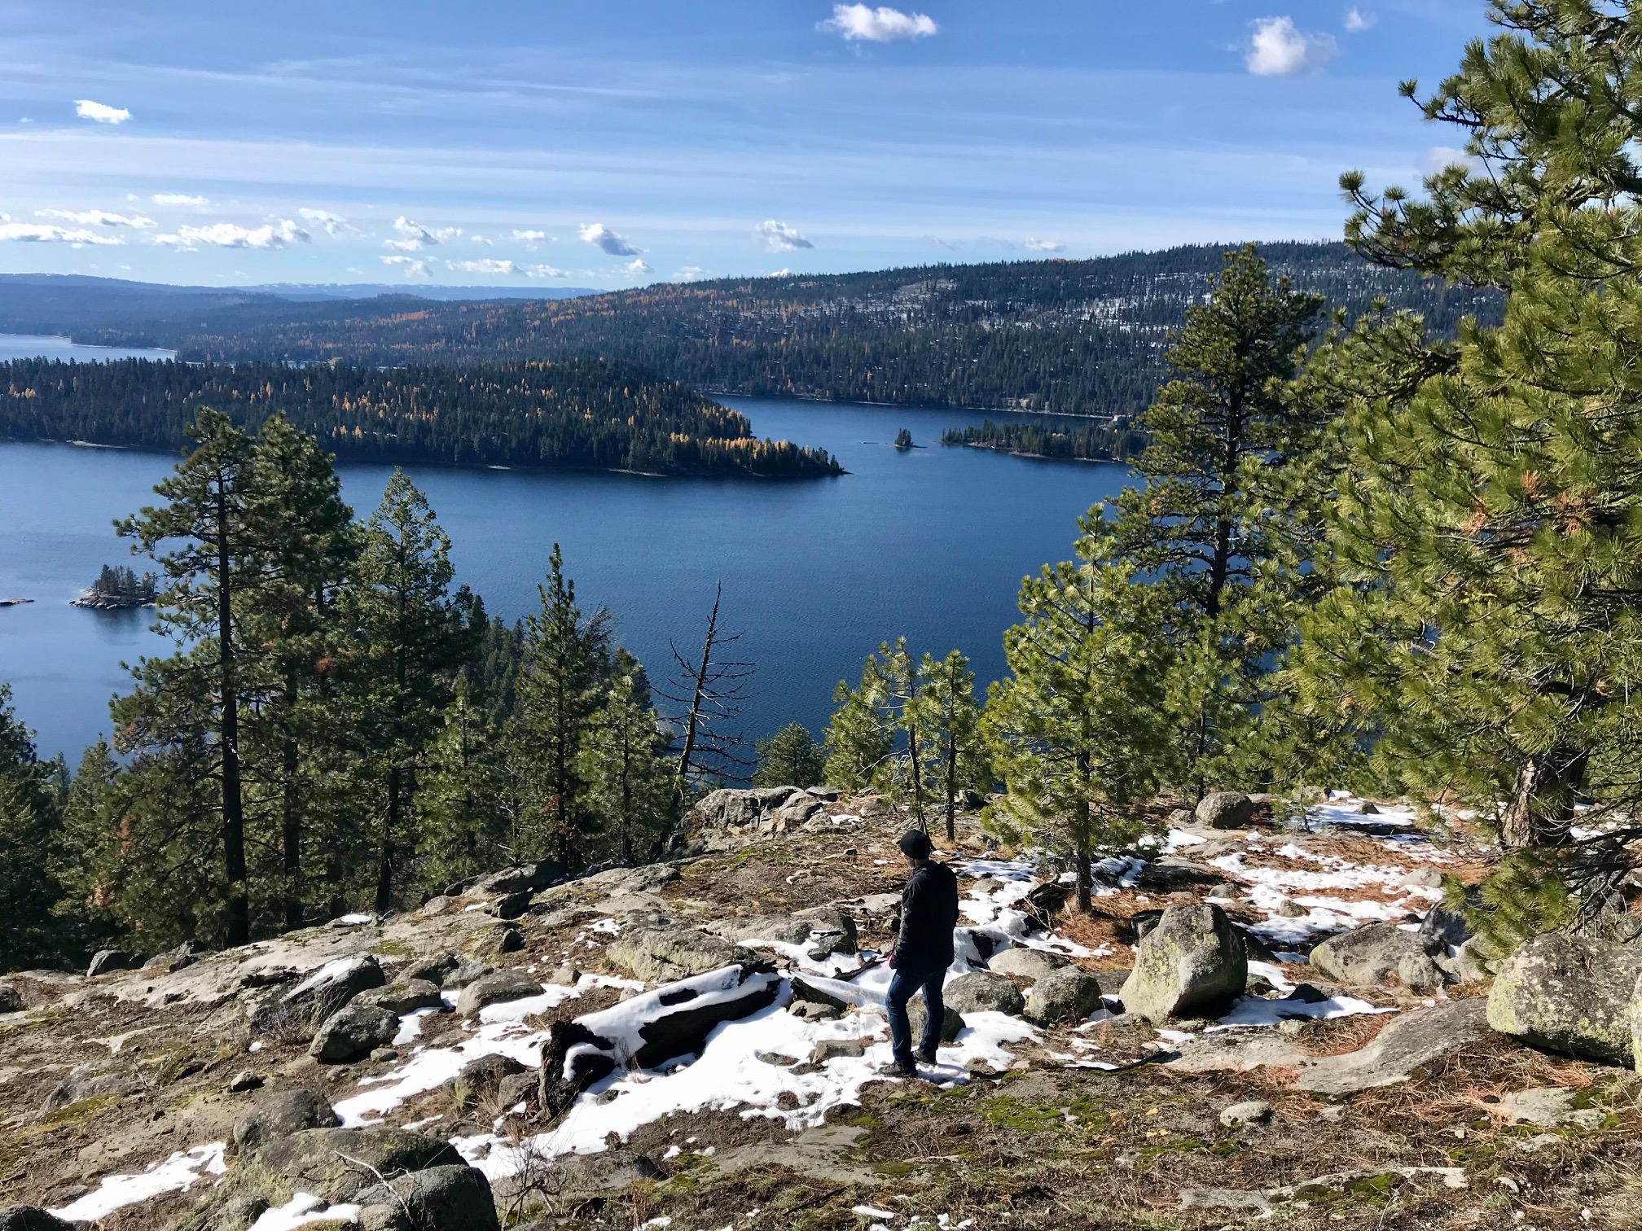
This observation from the 1978 plan was reflected many times during the current planning process: “….growth in population combined with the knowledge that Valley County is becoming ever more popular as a center of recreation and tourism makes it imperative that planning be instituted to preserve the open characteristics and scenic beauty of the county.”(Valley Count Comp Plan-2018 revision)
Notes:
So, what are the goals of Valley County? One of our goals is to ensure the long-term viability of our economy. As timber harvests have declined, outdoor recreation has increasingly become the major driver to the economy. Outdoor recreation depends on a healthy environment, abundant wildlife populations, and access to the forests and mountains in the area. It also requires wise stewardship of these areas including best practice resource management to ensure forest health and reduce fire and biological hazards. Recreation, development where appropriate, and forest management can go hand in hand, but require a comprehensive approach. As development becomes more lucrative, creative solutions need to be examined to offer long term alternatives to short term economic gain.

Slide 3
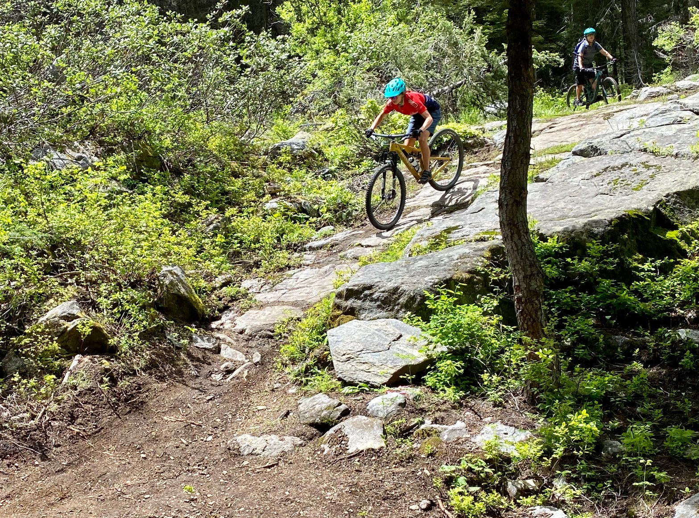
Annual benefits of bicycle recreation in popular bike destinations:
$57 million- NW Arkansas
$22 million- Grand County, UT(Moab)
$46 million- Whistler, BC
- 2018 Study of Economic and Health Benefits of
Bicycling to Northwest Arkansas
Payette Lake Trail-CIMBA
Notes:
I was asked to represent both Valley County and the Central Idaho Mountain Bike Association in the Focus Group. CIMBA has held a non-commercial lease on the west side of Payette Lake with IDL since 2016. CIMBA is currently developing a 33-mile trail on IDL lands that circumnavigates Payette Lake. The western portion of this trail built in 2019 links several existing trails together and connects the North Beach area on Warren Wagon Road to the City of McCall Bear Basin Connector Trail along Highway 55 with a modern, professionally built trail. Phase 2 of the project will connect North Beach to Ponderosa Park on the glacial rim above the east side of Payette Lake. The proposed alignment of this section of the trail winds through portions of IDL parcels E, H and I and will provide an incredibly unique and scenic trail system open to all non-motorized users. Valley County is quickly becoming known as a Mountain Bike destination due to the quality, quantity, and variety of our trail system on Federal, State and private properties in the area. The economic benefits of Mountain Biking are well documented in many areas. With careful planning and cooperation between local agencies, commercial interests like Jug Mountain Ranch, Brundage Mountain Resort and Tamarack Resort, and passionate, motivated groups like CIMBA, the mountain bike economy and other forms of recreation can become an even more significant source of income for Valley County.

Slide 4
The Focus Group is a great place for Valley County to work with IDL and other groups like CIMBA to achieve these goals. Utilizing innovative strategies such as Conservation Easements and Recreational Leases can help us find the balance between IDL’s mission, the goals of our Comprehensive Plan, and our booming recreation driven economy.
Notes:
With the Payette Endowment Lands Strategy and the variety of interests represented in the Focus Group, we have a unique opportunity to find consensus-based land management strategies that support both the mission of IDL in managing Endowment Lands and local economies. This is not going to happen quickly, alternatives to disposition of the lands surrounding Payette Lake and bordering Valley County are going to take time to develop. Let’s make sure we give ourselves the time to do this right.

Slide 5
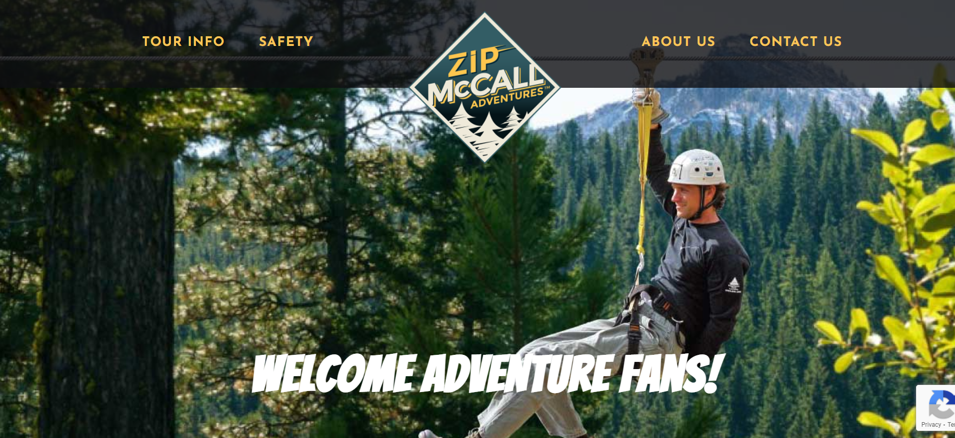
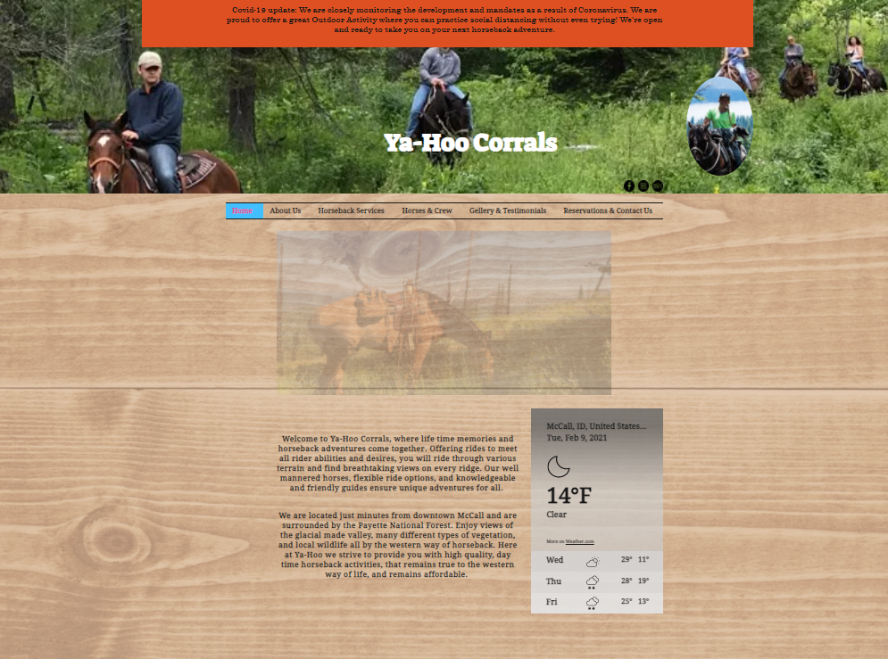
Payette Lake and the surrounding forest lands are a major attraction to the visitors that come to Valley County…
Zip McCall
Ya-Hoo Corrals
2018 Idaho Statewide Comprehensive Outdoor Recreation Plan(SCORP)-ID Dept. of Parks and Recreation
Notes:
Outdoor recreation relies on open spaces and guaranteed access to the areas we recreate in. Outdoor Recreation provided 7.8 billion dollars in 2017 to the Idaho economy and 78,000 jobs statewide. These jobs run across a wide spectrum from hotels, motels and restaurants, retail shops, rental shops to the guides and outfitters providing safe outdoor adventure vacations and once in a lifetime hunting opportunities throughout the state. Valley County IDL lands offer a variety of opportunities for Outdoor Recreation through tourist attraction and the associated businesses as well as commercial, and non-commercial lease opportunities.

Slide 6
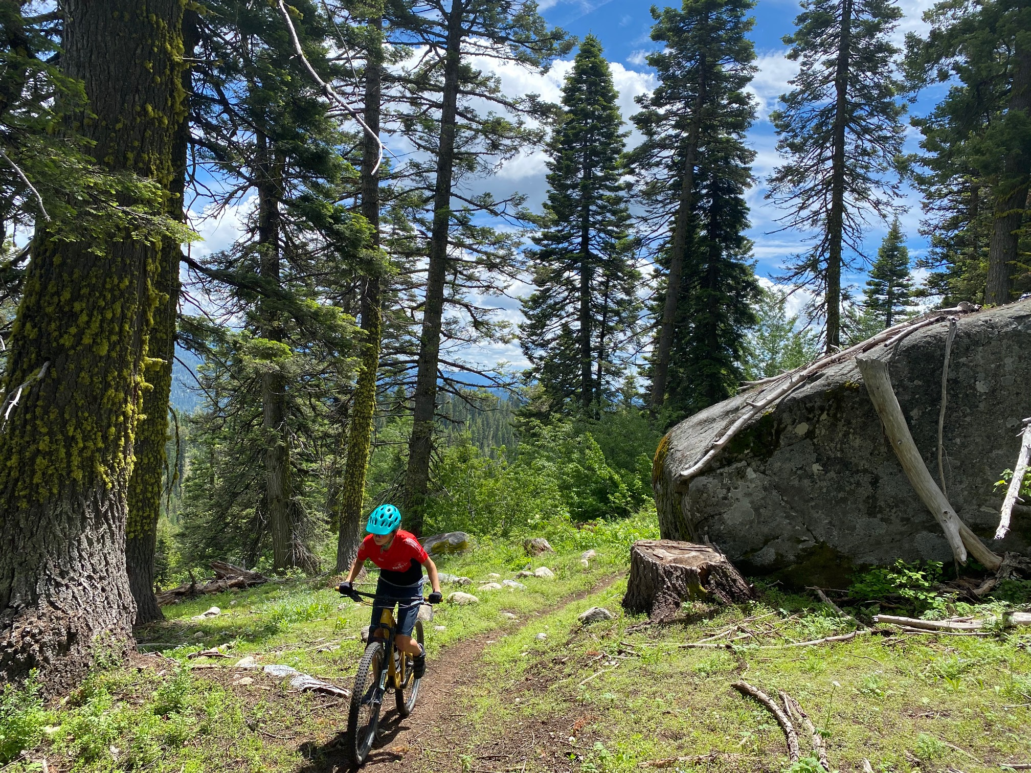
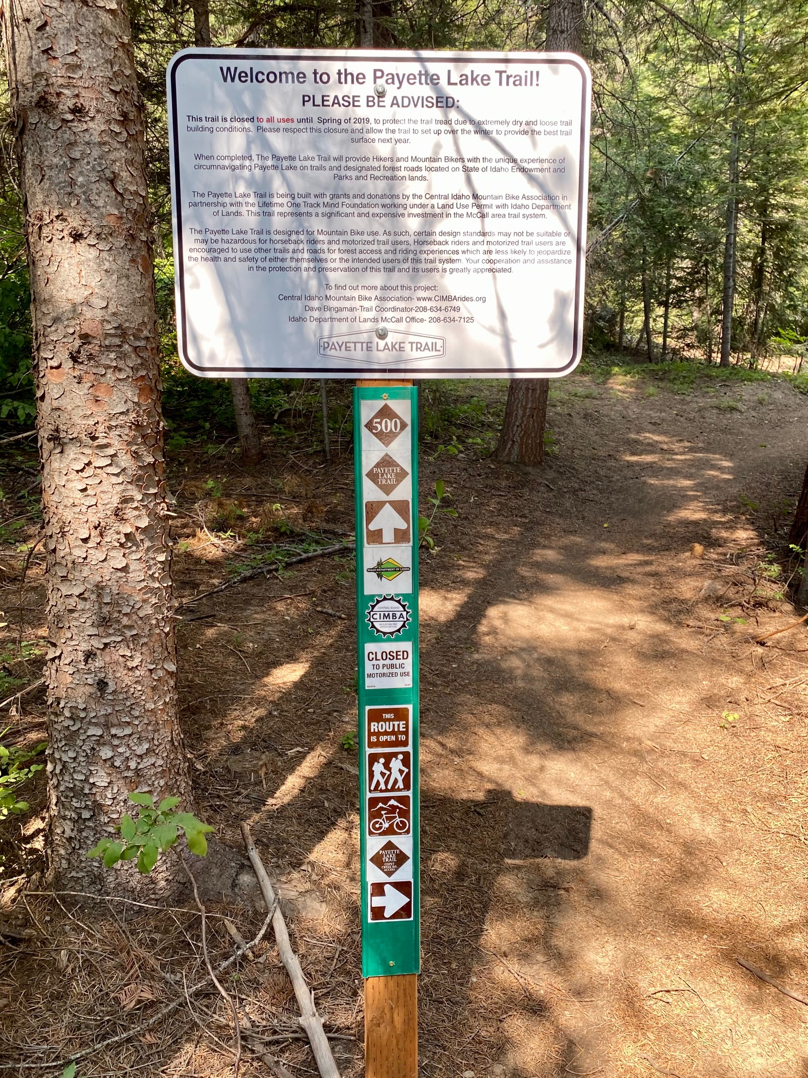
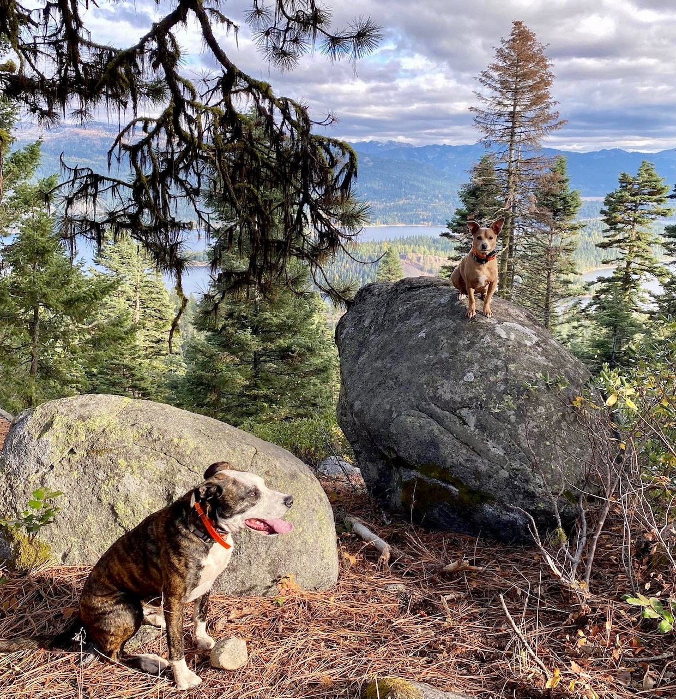
IDL should consider adding recreation, to its asset classification list. Recreation, combined with access and conservation have the ability to generate revenue in as yet untapped ways. These uses are also compatible with current IDL management strategies.
Valley County is a willing partner and looks forward to working with IDL to find solutions that benefit the endowment, the environment, and the local economy.
Notes:
The goals listed in the Idaho Statewide Comprehensive Outdoor Plan mirror the goals of Valley County and reiterate the need for a collaborative long-term approach to managing open spaces that are critical to resort communities. Recreation and recreational use on IDL lands is increasing every year. The opportunity for IDL to include recreation in its management strategy can compliment its current mission and duties to the Endowment. Managing recreation of these areas either internally or in conjunction with other groups is necessary to protect them from overuse and degradation and provides a longer-term revenue stream than a one-time sale. The degradation of these lands would have dire impacts on the tourist economy and could have negative effects on the water quality of two very popular lakes and the entire watershed of the North Fork of the Payette River which includes a municipal water supply, and irrigation water dedicated to areas within and outside of Valley County. The willingness to look at unique revenue streams including recreational leases and conservation easements can be viable alternatives to disposition of these unique Transition lands and help provide the income to close the earning gap while protecting the land. Valley County is very interested in working with IDL and other stakeholders to explore how conservation and continued agency management of our open spaces and neighboring forests can work hand in hand to provide long term benefits to the Endowment, our open spaces, our citizens, and the economy of Valley County.

Slide 7
Thank you for your time and the opportunity to participate in this group
References cited:
Valley County Comphrensive Plan 2018 revision available at: http://www.co.valley.id.us/wp-content/uploads/2018/11/2018-Compilation-online-2.pdf
BBC Research and Consulting. 2018. Economic and Health Benefits of Bicycling in Northwest Arkansas. Prepared for The Walton Family Foundation and PeopleForBikes. Denver, CO: BBC Research and Consulting. https://www.imba.com/sites/default/files/content/resources/2018-06/march-2018-nw-arkansas-final-report-corrected.pdf
Idaho Parks and Recreation Statewide Comprehensive Outdoor Recreation Plan 2018-2022. https://parksandrecreation.idaho.gov/wp-content/uploads/scorp/Idaho-Statewide-Comprehensive-Outdoor-Recreation-Plan-2018-1.pdf
Contact: dbingaman@co.valley.id.us

