Slide 1


IDAPA 20.03.15
Geothermal Leasing
Public Meeting
March 28, 2024 – 9:00 am
Mike Murphy (208) 334-0290

Slide 2
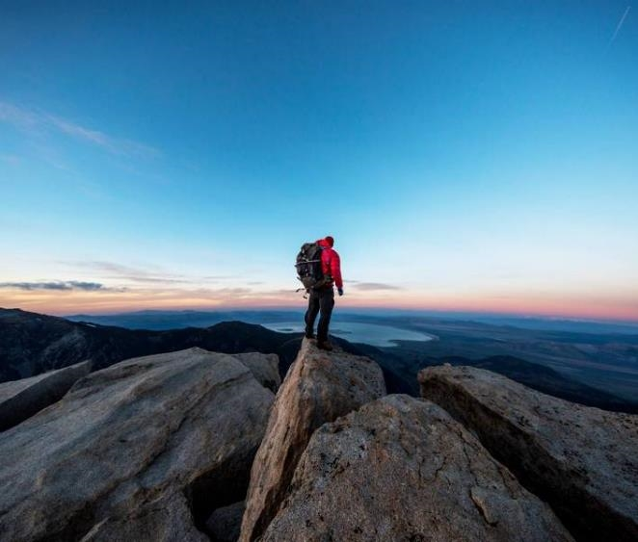

Agenda
Welcome and Introductions
Rulemaking Timeline/Participation
Draft Negotiated Rule/Discussion
Review Next Steps
  2nd Meeting
  Comments

Slide 3
Negotiated Rulemaking Timeline
Land Board Approval
The Land Board approved moving forward with the rulemaking for IDAPA 20.03.15 on January 16, 2024.
Part of 5-year review cycle for all IDL Rules
Notice of Intent
The Notice of Intent for rulemaking was published in the March 2024 Idaho Administrative Bulletin.
Public Meetings
1st Meeting
March 28, 2024
2nd Meeting
April 10, 2024
1:00 pm
IDL Office - Boise
Proposed Rule
Public comment period ends:
April 19, 2024
Proposed Rule is published in
July 2024
Public Hearing on Proposed Rule in July 2024 (TBD)
Pending Rule
Request Land Board approval of Pending Rule – August 2024
The Pending Rule will be reviewed by 2025 Legislature

Slide 4
submit comments by
April 19, 2024 rulemaking@idl.idaho.gov
Next Public Meeting
April 10, 2024 – 9:00 am

