Slide 1
Negotiated Rulemaking for IDAPA 20.03.13 Administration of Cottage Site Leases on State Lands
Public Meeting #1
March 27, 2024
1:00 p.m. (MT)

Slide 2
Agenda
01. Introductions and Brief Overview
02. Negotiated Rulemaking Timeline
03. Draft Rule and Discussion
04. Notable Next Steps
05. Conclusion

Slide 3
Introductions and Brief Overview
Kemp Smith
Jason Laney
Tammy Armstrong
Commercial and Residential Leasing Program Manager
Leasing Section Manager
Real Estate Program Specialist

Slide 4
Negotiated Rulemaking Timeline Essential Dates
Land Board Approval
The Land Board approved moving forward with the rulemaking for IDAPA 20.03.13 on January 16, 2024.
Part of 5-year review cycle for all IDL Rules.
Notice of Intent
The Notice of Intent to Promulgate Rules was published in the March 6, 2024 edition of the Idaho Administrative Bulletin.
Public Meetings
1st Meeting
March 27, 2024
1:00 p.m.
Boise and Zoom
Proposed Rule
Public comment period for negotiated rulemaking ends:
April 17, 2024
Notice of Proposed Rule is published in the July 2024 Idaho Administrative Bulletin.
Pending Rule
Request Land Board approval of Pending Rule: August 20, 2024
Pending rule will be reviewed by the Idaho Legislature during the 2025 legislative session.
2nd Meeting
April 8, 2024
1:00 p.m.
Boise and Zoom
March 27, 2024

Slide 5
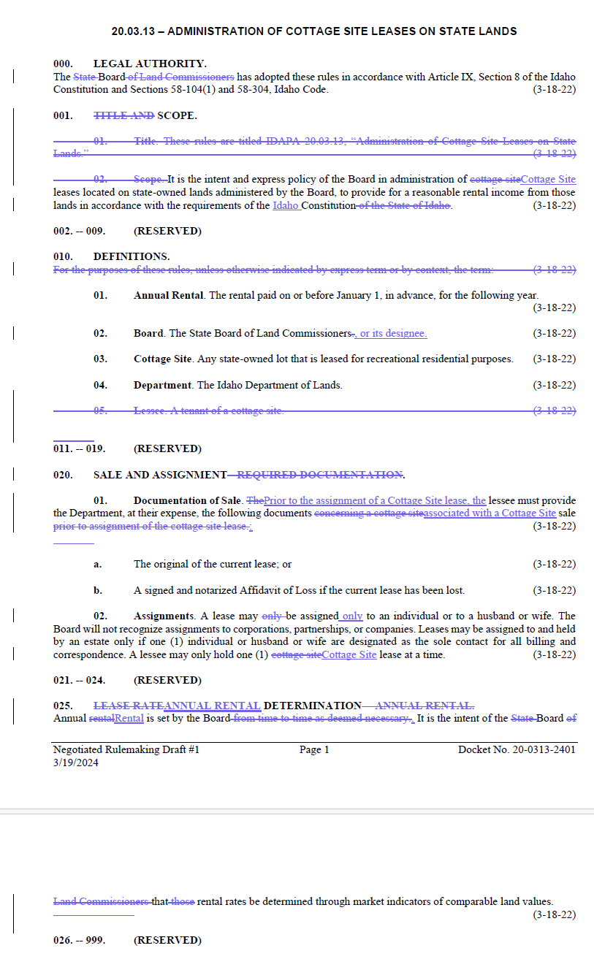
Draft Rule and Discussion

Slide 6
Notable Next Steps
Second Public Meeting
April 8, 2024 at 1:00 p.m.
Deadline for Negotiated Rulemaking Written Comments
April 17, 2024
IDL to seek Land Board Approval of Proposed Revised Rule
August 20, 2024

Slide 7
Thank you for attending!
Second Public Meeting: April 8, 2024 at 1:00 p.m. For negotiated rulemaking, written comments to rulemaking@idl.idaho.gov are due by April 17, 2024.

